Slide 1
Introduction to Statistical Methods(ISM)

Slide 2
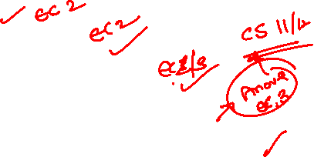
Agenda
Probability Distributions:-
Bernoulli
Binomial
Poisson
Normal distributions.
Introduction to t-distribution
Introduction to F-Distribution and
Introduction to Chi Square distributions
Session 6
(30th May 2026)
Probability Distributions

Slide 3
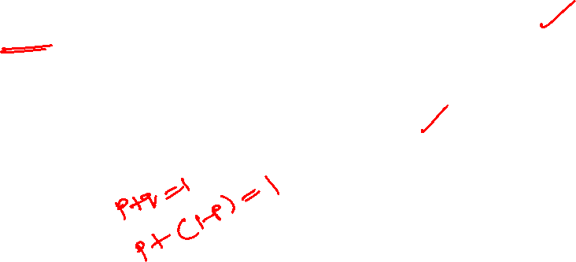
Bernoulli Distribution
A random experiment that can only have an outcome of either 1 or 0 is known as a Bernoulli trial.
In other words, the random variable can be 1 with a probability p or it can be 0 with a probability (1 - p). Such an experiment is called a Bernoulli trial.
A discrete probability distribution wherein the random variable can only have 2 possible outcomes is known as a Bernoulli Distribution.

Slide 4
Bernoulli Distribution
Bernoulli Distribution can be used to describe events that can only have two outcomes, that is, success or failure.
Bernoulli distribution is a special case of binomial distribution when only 1 trial is conducted.
Example:
A pass or fail exam can be modeled by a Bernoulli Distribution.
2) A basketball player can shoot a ball into the basket with a probability of 0.6.
What is the probability that he misses the shot?
Solution: We know that success probability P (X = 1) = p = 0.6
Thus, probability of failure is P (X = 0) = 1 - p = 1 - 0.6 = 0.4
The probability he misses the shot is 0.4.

Slide 5
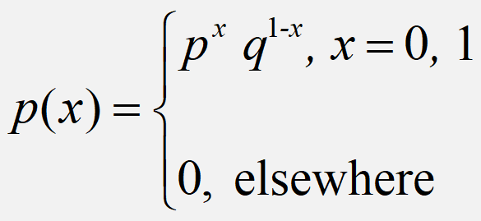
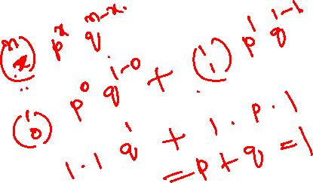
Bernoulli Distribution
A random variable ‘X’ is said to have
Bernouli distribution if its probability mass
function is given by
Definition
This represents a single trial with two possible outcomes (usually labeled as success/failure or 1/0) where success has a probability p and failure has a probability q = 1 - p.

Slide 6
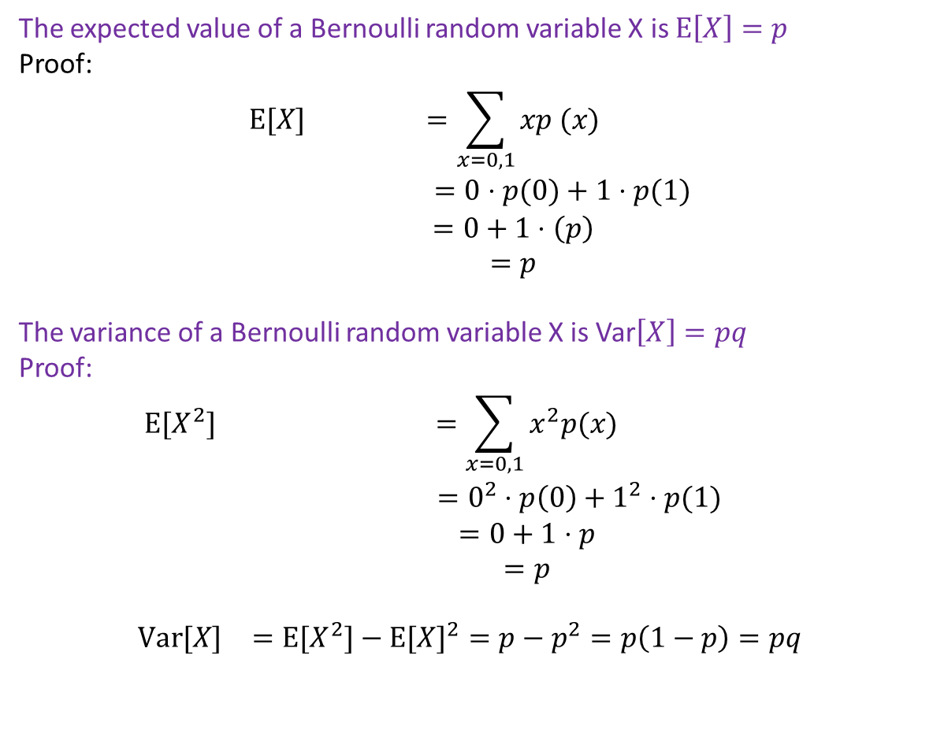

Mean & Variance of Bernoulli distribution
The expected value of a Bernoulli random variable X is $E\left[X\right]=p$
Proof:
$$\begin{matrix}E[X] & =\sum_{x=0,1}{xp (x)} \\ & =0⋅p(0)+1⋅p(1) \\ & =0+1⋅\left(p\right) \\ & =p\end{matrix}$$
The variance of a Bernoulli random variable X is Var$\left[X\right]=pq$
Proof:
$$\begin{matrix}E[X^{2}] & =\sum_{x=0,1}{x^{2}p(x)} \\ & =0^{2}⋅p\left(0\right)+1^{2}⋅p(1) \\ & =0+1⋅p \\ & =p \\ & \\ Var[X] & =E[X^{2}]−E[X]^{2}=p−p^{2}=p\left(1−p\right)=pq\end{matrix}$$

Slide 7
Bernoulli distribution: Applications
Quality Control: In manufacturing, every product undergoes quality checks. Bernoulli Distribution helps assess whether a product passes (success) or fails (failure) the quality standards.
Market Research: Bernoulli Distribution is useful in surveys and market research when dealing with yes/no questions.
Risk Assessment: In the context of risk management, the Bernoulli Distribution can be applied to model events with binary outcomes, such as a financial investment succeeding (success) or failing (failure).
Marketing Campaigns: Businesses use Bernoulli Distribution to measure the effectiveness of marketing campaigns.

Slide 8
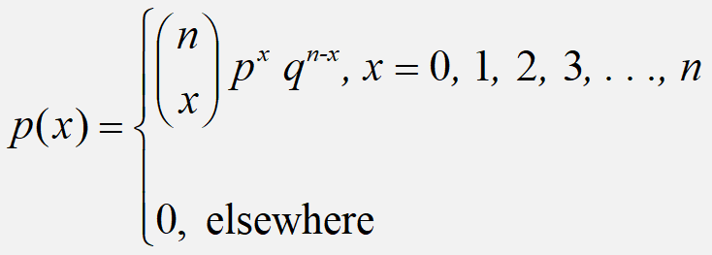
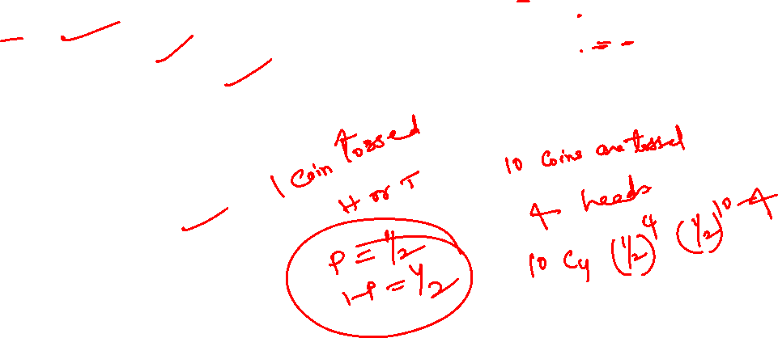
Binomial Distribution
A random variable ‘X’ is said to have Binomial distribution if its probability mass function is given by
Definition
Binomial distribution is a discrete probability distribution.
Binomial distribution will be applied under the following experimental conditions
The number of trials (n) is finite
The trials are independent of each other
The probability of success p is constant for
each trial.
Each trial results in two mutually exclusive events known as success and failure.

Slide 9
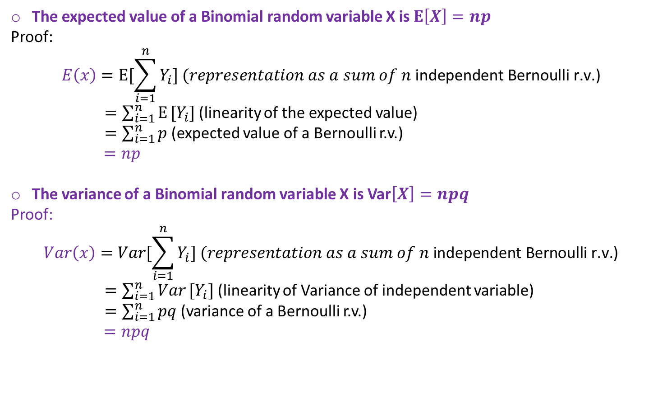
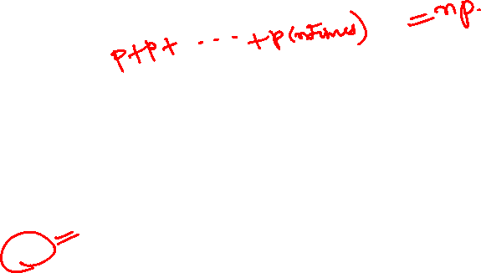
Mean & Variance
The expected value of a Binomial random variable X is $E\left[X\right]=np$
Proof:
$$E\left(x\right)=E[\sum_{i=1}^{n}{Y_{i}}] (representation as a sum of n\text{ independent Bernoulli r.v.)}$$
$=\sum_{i=1}^{n}{E}[Y_{i}]$ (linearity of the expected value)
$=\sum_{i=1}^{n}{p}$ (expected value of a Bernoulli r.v.)
$=np$
The variance of a Binomial random variable X is Var$\left[X\right]=npq$
Proof:
$$Var\left(x\right)=Var[\sum_{i=1}^{n}{Y_{i}}] (representation as a sum of n\text{ independent Bernoulli r.v.)}$$
$=\sum_{i=1}^{n}{Var}[Y_{i}]$ (linearity of Variance of independent variable)
$=\sum_{i=1}^{n}{pq}$ (variance of a Bernoulli r.v.)
$=npq$

Slide 10
Binomial Distribution-Check:
Which conditions for the binomial distribution, if any, fail to hold in each of the following situations?
(a)The number of persons getting Corona in a room of 30 persons.
Ans: Getting corona is not independent. So, it is not binomial.
(b) Consider 2 out of 20 projectors are defective. We randomly select 3 for testing. Is this a binomial experiment?
Ans: If two defective pieces are in the first two selection, then the result of third is known already. Thus, the event is not independent. So, this is not binomial.

Slide 11
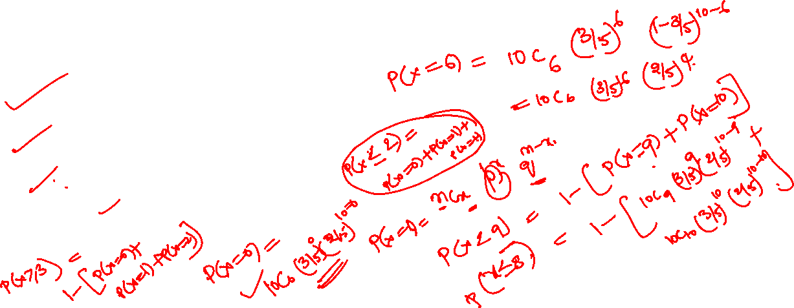
Example 1:
In a particular restaurant, an average of 3 out of every 5 customers ask for water with their meal. A random sample of 10 customers is selected. Find the probability that
(i) Exactly 6 ask for water with their meal,
(ii) Less than 9 ask for water with their meal.
(iii) No one asks for water with their meal?
(iv) At most 2 ask for water with their meal?
(v) At least 3 ask for water with their meal?

Slide 12
Solution:
n =10 , p = 3/5=0.6, q= 1-p = 0.4
(i) p(6) = 0.251
(ii) p(less than 9) =1- [p(9)+p(10)]= 0.954
(iii) p(0) = 0.0001
(iv) p(at most 2) = p(0) + p(1) + p(2) =0.0001+0.0016+0.0106 = 0.0123
(v) p(at least 3) = p(3)...+ p(10) = 1 – [p(0) + p(1)+ p(2)] = 0.9877

Slide 13
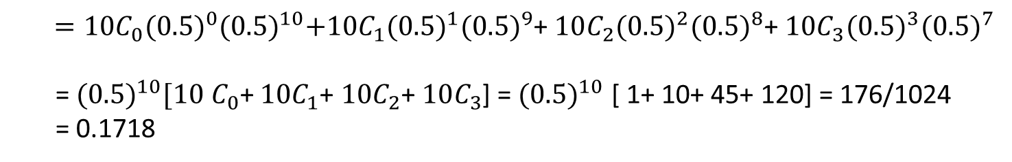
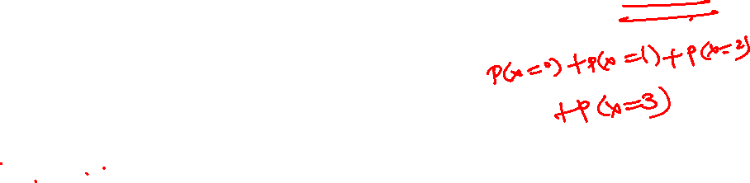
Example 2:
Ten coins are thrown simultaneously. what is the probability of getting 3 or fewer heads?
Solution:
P(x ≤ 3) = ∑p(x) = P(0)+ P(1)+ P(2)+P(3)
$=10C_{0}{(0.5)}^{0}{(0.5)}^{10}+10C_{1}{(0.5)}^{1}{(0.5)}^{9}$+ $10C_{2}{(0.5)}^{2}{(0.5)}^{8}$+ $10C_{3}{(0.5)}^{3}{(0.5)}^{7}$
= ${(0.5)}^{10}[10$ $C_{0}$+ $10C_{1}$+ $10C_{2}$+ $10C_{3}$] = ${(0.5)}^{10}$ [ 1+ 10+ 45+ 120] = 176/1024
= 0.1718
P(x ≤ 3) = ∑p(x) = 0.1718

Slide 14
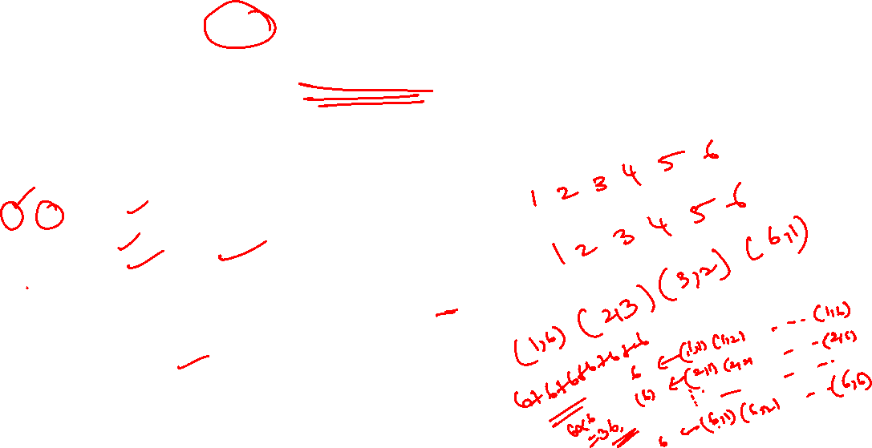
Example 3:
A pair of dice is rolled 5 times. If getting the product of 6 is considered as a success. Find the probability of getting at least 4 successes.
Solution:
The formula for the above probability is given by:P (X = x) = ^{n}C_{x} p^{x} q^{n-x}
Here, n = 5
p is the probability of getting product 6
p = 4 /36 = 1/9
q = 1 - p = 8/9
⇒ P(X ≥ 4) = P(X = 4) + P(X = 5)
⇒ P(X ≥ 4) = ⁵C₄ (1/9)⁴ (8/9)⁵⁻⁴+ ⁵C₅ (1/9)⁵ (8/9)⁵⁻⁵
⇒ P(X ≥ 4) = 5(1/9)⁴ (8/9) + (1/9)⁵
^{= 0.000694335}

Slide 15
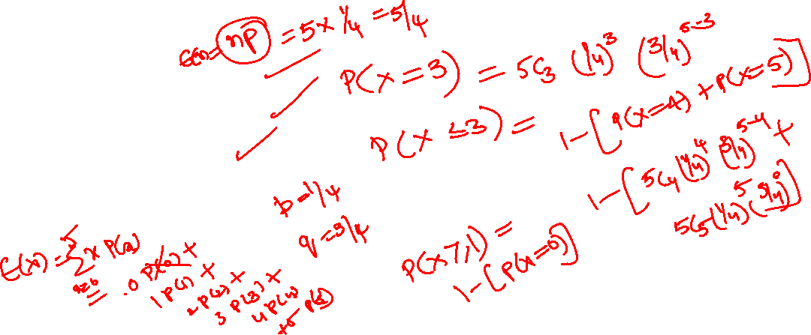
Example 4:
Each of five questions on a multiple-choice examination has four choices, only one of which is correct. The student is attempting to guess the answers. The random variable X is the number of questions answered correctly. What is the probability that the student will get
a) exactly three correct answers?
b) at most three correct answers?
c) at least one correct answer?
d) Find Mean and variance.

Slide 16
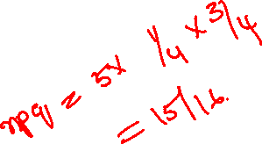
Solution:
p=1/4, n=5, q=3/4;
a)P(X=3)= 45/512 = 0.08789
b) P(X<=3)=63/64;
c) P(X>=1)= 0.7627
d) Mean = 5/4
Variance = 15/16.

Slide 17
Recall : Binomial Distribution
A binomial experiment is a probability experiment that satisfies the following conditions.
1. The experiment is repeated for a fixed number of trials, where each trial is independent of other trials.
2. There are only two possible outcomes of interest for each trial. The outcomes can be classified as a success (S) or as a failure (F).
3. The probability of a success P (S) is the same for each trial.
4. The random variable x counts the number of successful trials.

Slide 18
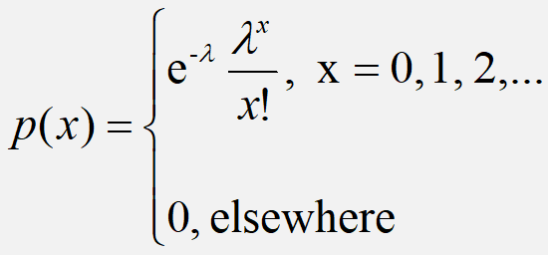
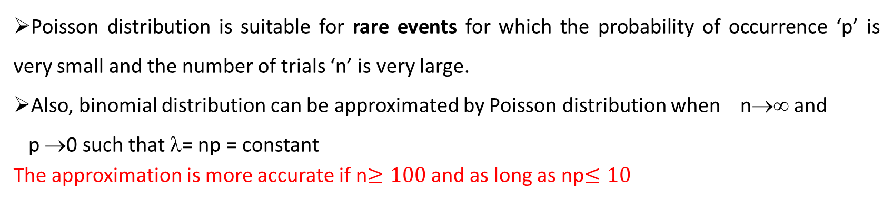
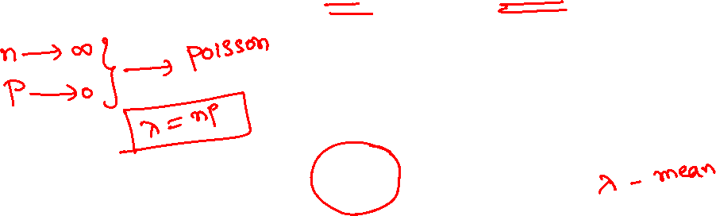
Poisson Distribution
A random variable ‘X’ is said to have Poisson distribution if its probability mass function is given by
Poisson distribution is suitable for rare events for which the probability of occurrence ‘p’ is very small and the number of trials ‘n’ is very large.
Also, binomial distribution can be approximated by Poisson distribution when n→∞ and
p →0 such that λ= np = constant
The approximation is more accurate if n$≥100$and as long as np$≤10$
Definition

Slide 19
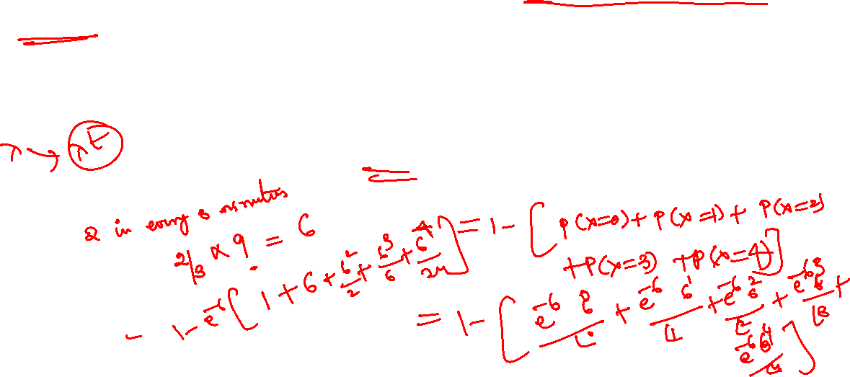
Example 5:
Telephone calls enter a college switchboard on the average of two every three minutes. What is the probability of 5 or more calls arriving in a 9-minute period?
Solution:

Slide 20
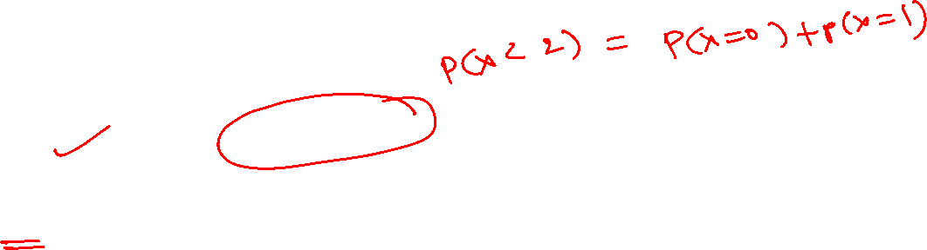
Example 6:
If 3% of electronic units manufactured by a company are defective. Find the probability that in a sample of 200 units, less than 2 bulbs are defective.
Solution:
The probability of defective units p = 3/100 = 0.03
Give n = 200.
We observe that p is small and n is large here. Thus, it is a Poisson distribution.
Mean λ= np = 200 × 0.03 = 6
P(X= x) is given by the Poisson Distribution Formula as (e^{-λ} λ^{x} )/x!
P(X < 2) = P(X = 0) + P(X= 1)
=(e⁻⁶ 6⁰ )/0! + (e⁻⁻⁶6¹ )/1!
= e⁻⁶ + e⁻⁻⁶ × 6
= 0.00247 + 0.0148
P(X < 2) = 0.01727

Slide 21
Mean and Variance
Mean:
For a Poisson random variable, the variance and mean are the same!
Variance and Standard Deviation
where λ= expected number of occurrences in a given experiment.

Slide 22
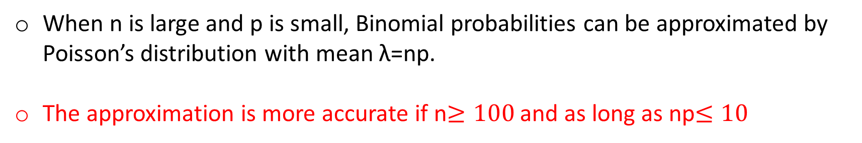
Poisson approximation to Binomial distribution :
When n is large and p is small, Binomial probabilities can be approximated by Poisson’s distribution with mean λ=np.
The approximation is more accurate if n$≥100$and as long as np$≤10$

Slide 23
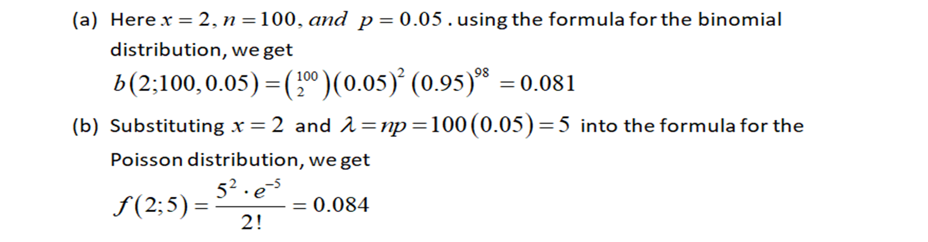
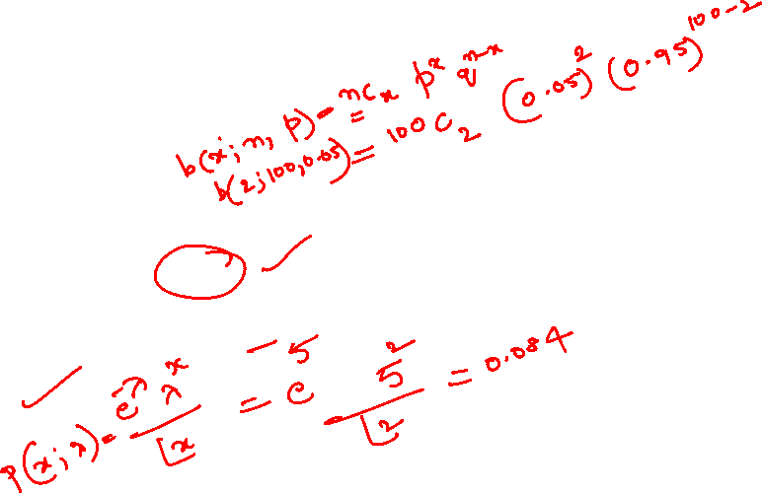
Example 7:
It is known that 5% of the books bound at a certain bindery have defective bindings. Find the probability that 2 of 100 books bound by this bindery will have defective bindings using
(a)The formula for the binomial distribution;
(b)The Poisson approximation to the binomial distribution

Slide 24
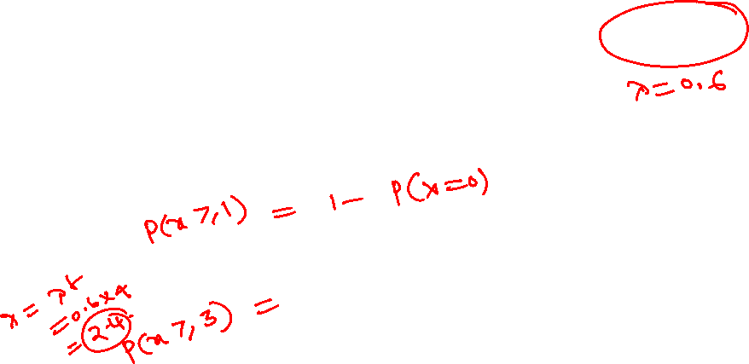
Example 8:
Given that a switch board of a consultant’s office receives on the average 0.6 calls per minute, find the probabilities that
(a) in a given minute there will be at least 1 call;
(b) in a 4-minute interval there will be at least 3 calls.

Slide 25
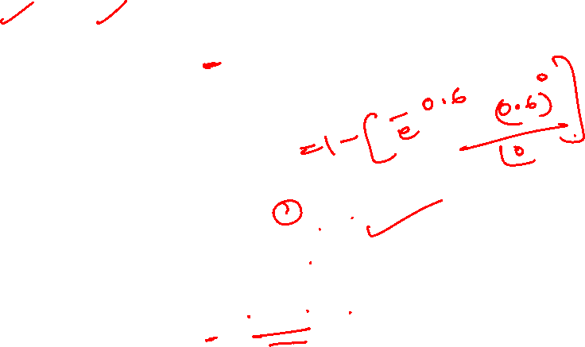
Solution:
a) Here,
b)

Slide 26
Poisson Distribution: Applications
Arrivals at queuing systems:
Airports : people, airplanes, automobiles, baggage
Banks: people, loan applications
computer file servers : read and write operations
Defects in manufactured goods:
number of defects per 1,000 feet of extruded copper wire
number of blemishes per square foot of painted surface
number of errors per typed page

Slide 27
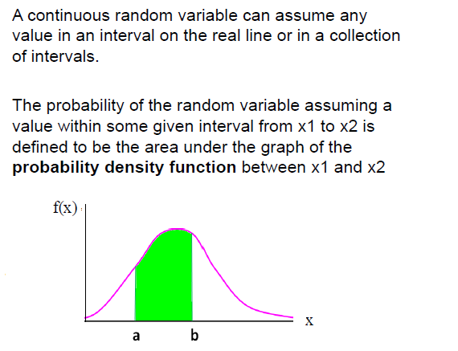
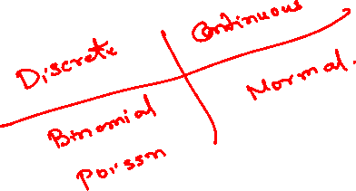
RECALL: Continuous Random Variables
Example:
Height of students in a class
Amount of ice tea in a glass
Change in temperature throughout a day
Price of a car in next year

Slide 28

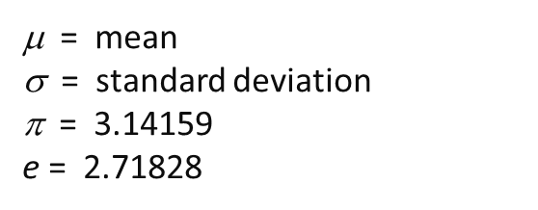
Normal Distribution:
Normal Distribution : Normal distribution is a general distribution. Any information such as heights, weights, lengths, widths, sizes, profits, prices, wages, time etc. containing sufficiently large data with mean and variance follows normal distribution.
The distribution of errors of repeated measurements follows normal distribution.
A continuous random variable X which assumes all possible values in the entire real space, i.e., -∞<x<∞ is said to follow normal distribution with two parameters such as mean μ and variance σ² if it has the probability density function given by

Slide 29

Normal Distribution
f(X)
Changing μ shifts the distribution left or right.
Changing σ increases or decreases the spread.
σ
Properties:
1. Normal curve is bell shaped and symmetric about the mean
2. Mean = Mode = Median
3. Total area under normal curve is equal to 1
4. Normal curve approaches but never touches the x axis as it extends farther and farther away from the mean

Slide 30
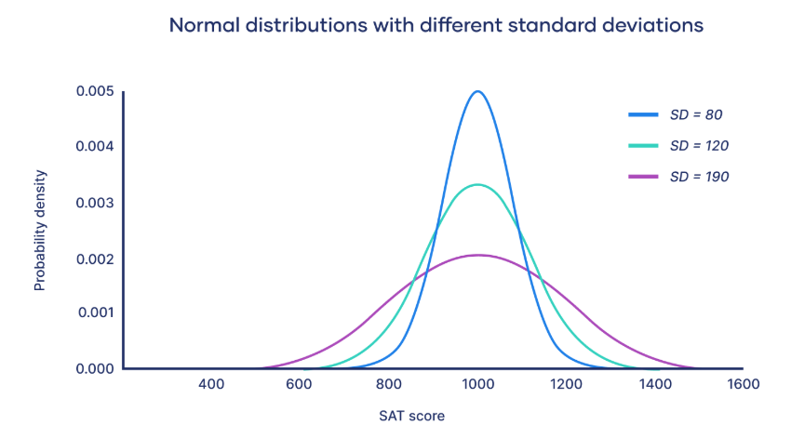
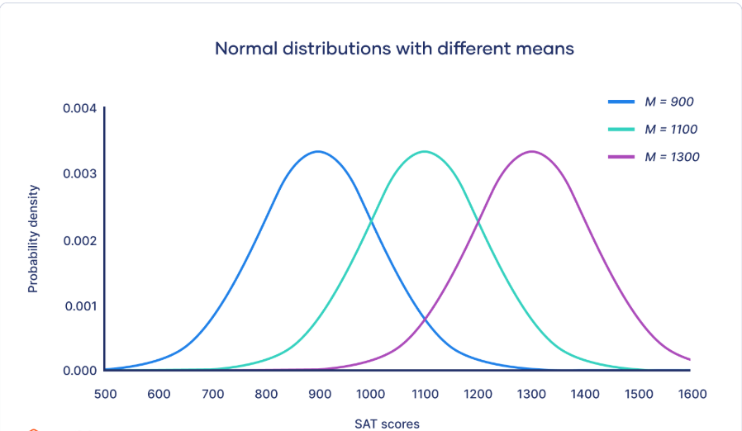
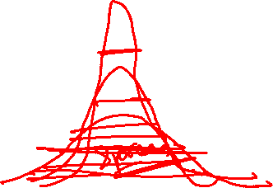
Normal Distribution
Empirical rule
The empirical rule, or the 68-95-99.7 rule, tells you where most of your values lie in a normal distribution:
Around 68% of values are within 1 standard deviation from the mean.
Around 95% of values are within 2 standard deviations from the mean.
Around 99.7% of values are within 3 standard deviations from the mean.

Slide 31
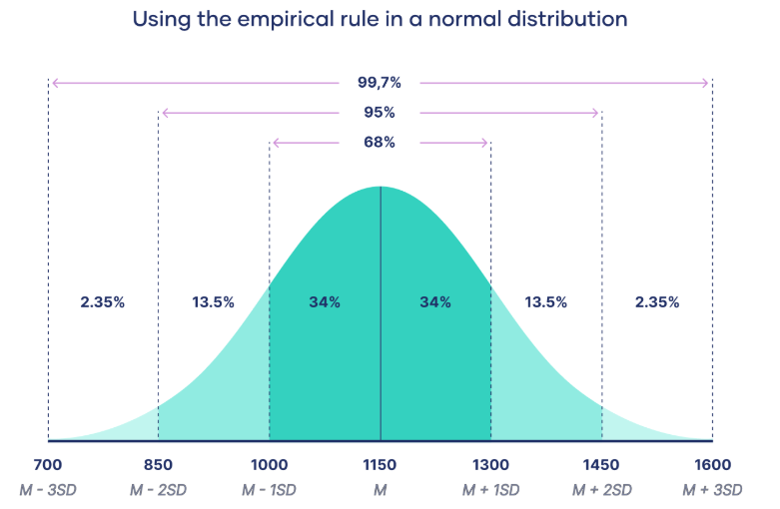
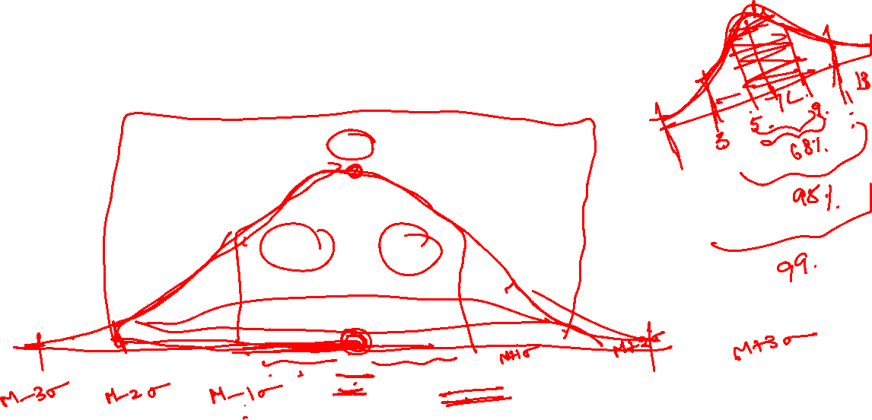
Area under normal curve
No matter what μ and σ are, the area between μ-σ and μ+σ is about 68%; the area between μ-2σ and μ+2σ is about 95%; and the area between μ-3σ and μ+3σ is about 99.7%. Almost all values fall within 3 standard deviations.

Slide 32
Normal Distribution: Mean and Variance
E(X)=μ =
Var(X)=σ² =
Standard Deviation(X)= σ

Slide 33
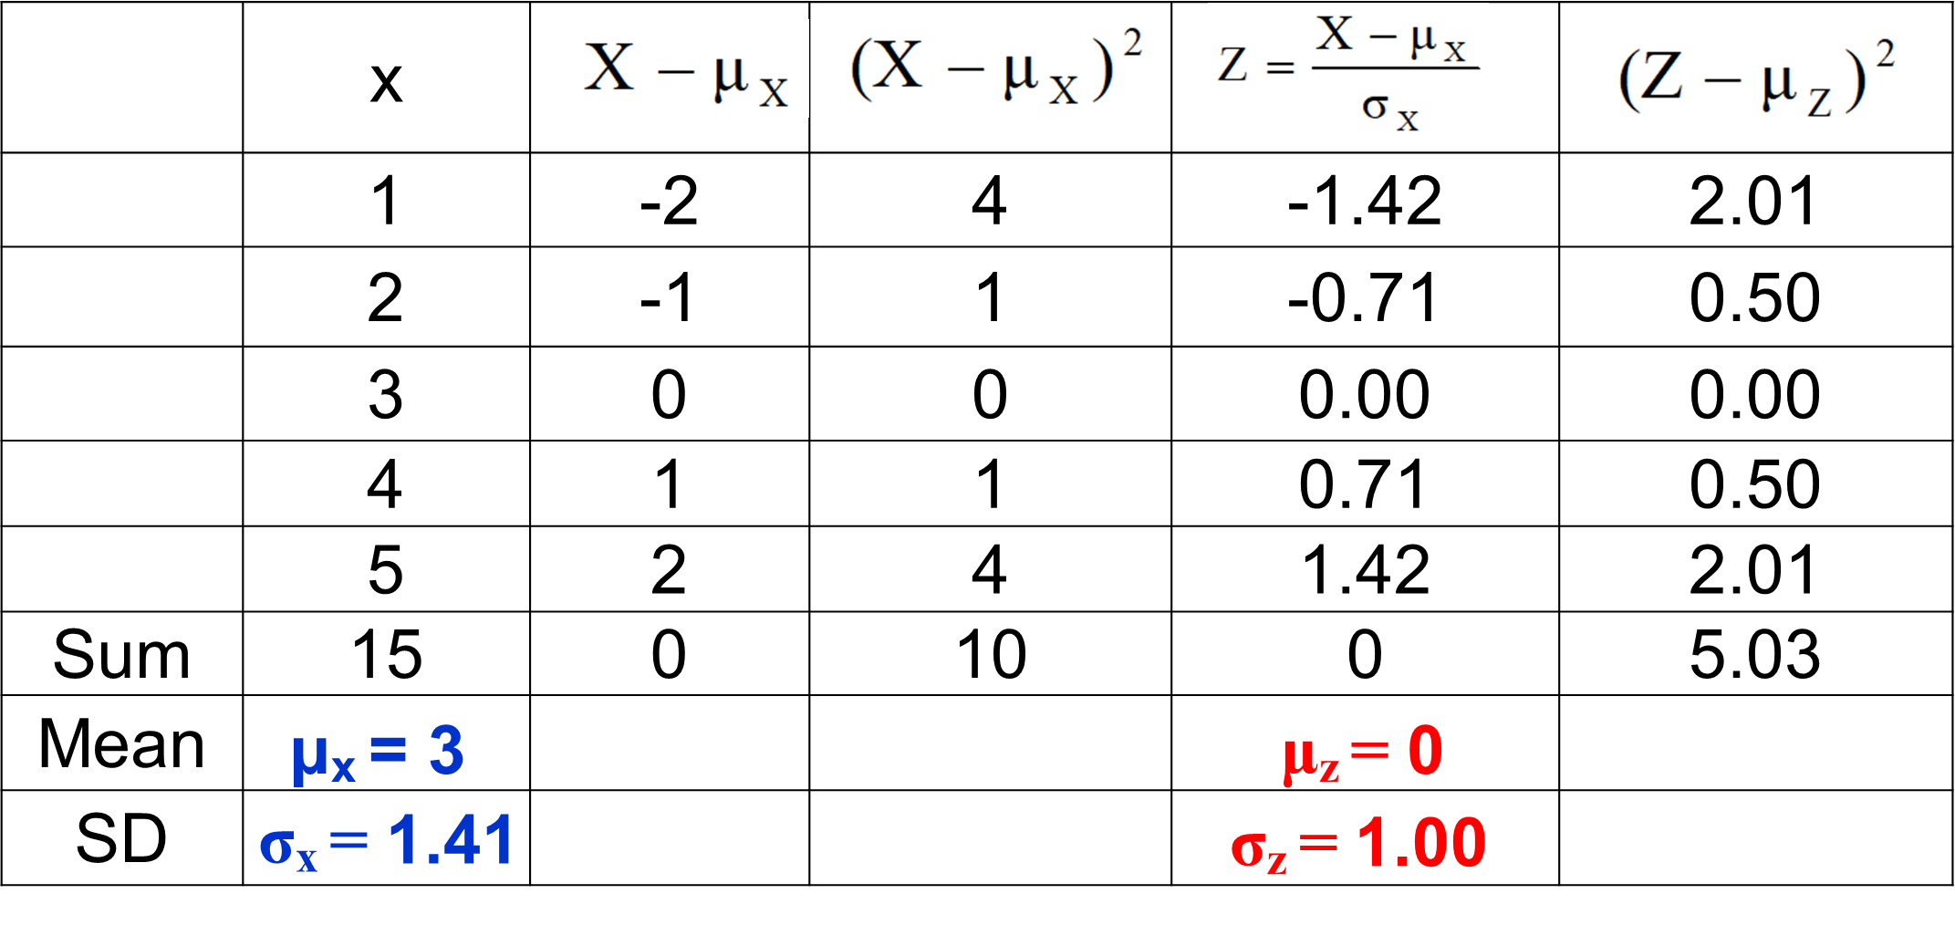
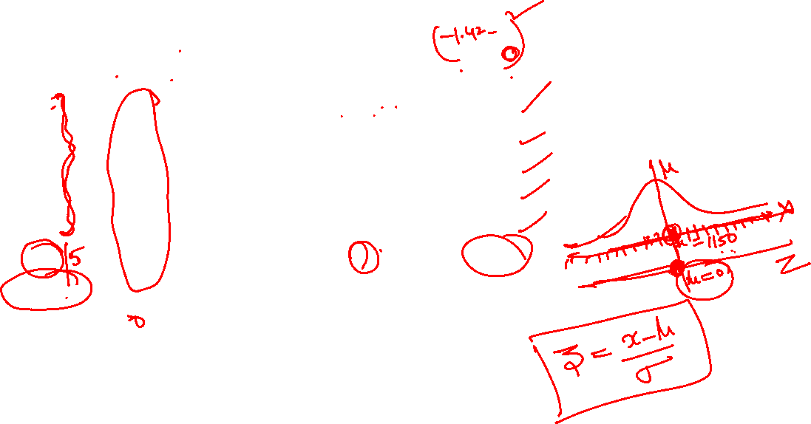
Why Standard Normal Distribution?
X ~ N(µ, σ²) → Z ~ N(0, 1). This is true for any data size

Slide 34
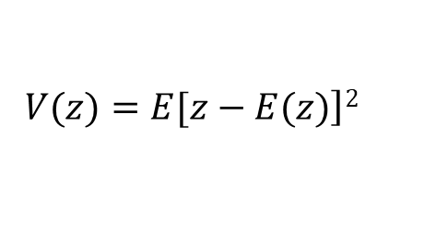


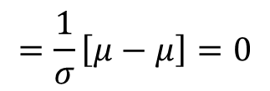

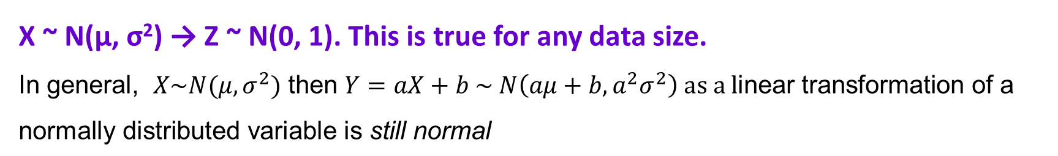

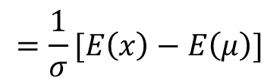



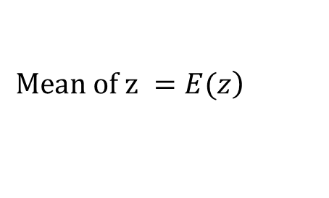


Why Standard Normal Distribution?
$Z=\frac{X−μ}{σ}$
$$\left.Mean of z =E(z\right)$$
=E$( \frac{x−μ}{σ}$)
$$=\frac{1}{σ}[E\left(x\right)−E\left(μ\right)]$$
$$=\frac{1}{σ}\left[μ−μ\right]=0$$
$$\left.V(z)=E[z−E(z)\right]2$$
$=E(z$²)
$As E(z$)=0
=E$( \frac{x−μ}{σ}$)²
=$\frac{1}{σ^{2}}E\left(x−μ\right)2$
AS $v(ax)=a^{2}$ $v(x)$
= $\frac{1}{σ^{2}}$ $σ^{2}$ =1
X ~ N(µ, σ²) → Z ~ N(0, 1). This is true for any data size.
In general, $X\sim N(μ, σ^{2})$ then $Y=aX+b \sim N\left(aμ+b, a^{2}σ^{2}\right) \text{as a l}\text{inear transformation of a normally distributed variable is }\text{still normal}$

Slide 35
Standard Normal Distribution
The standard normal distribution is a normal distribution with a mean of 0 and a standard deviation of 1.
All normal distributions can be converted into the standard normal curve by subtracting the mean and dividing by the standard deviation.

Slide 36
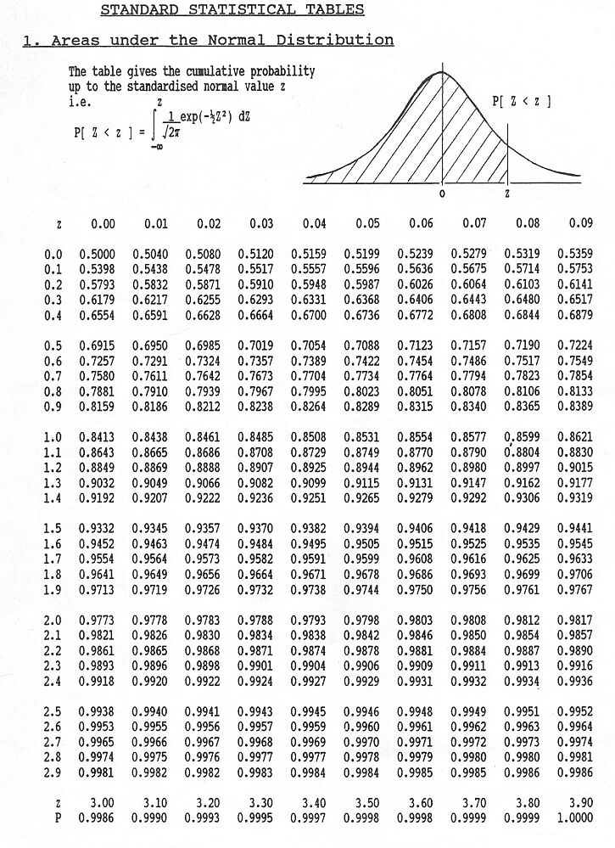
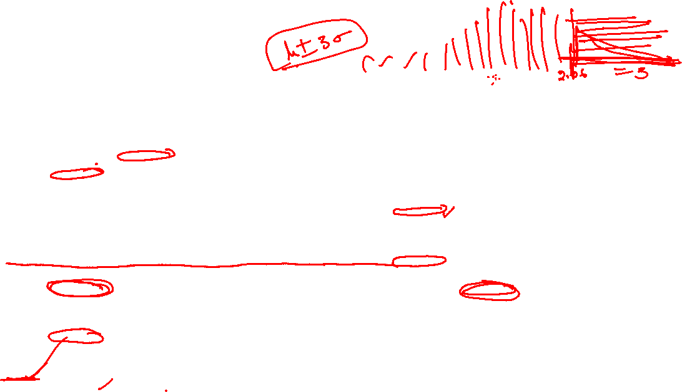

Slide 37
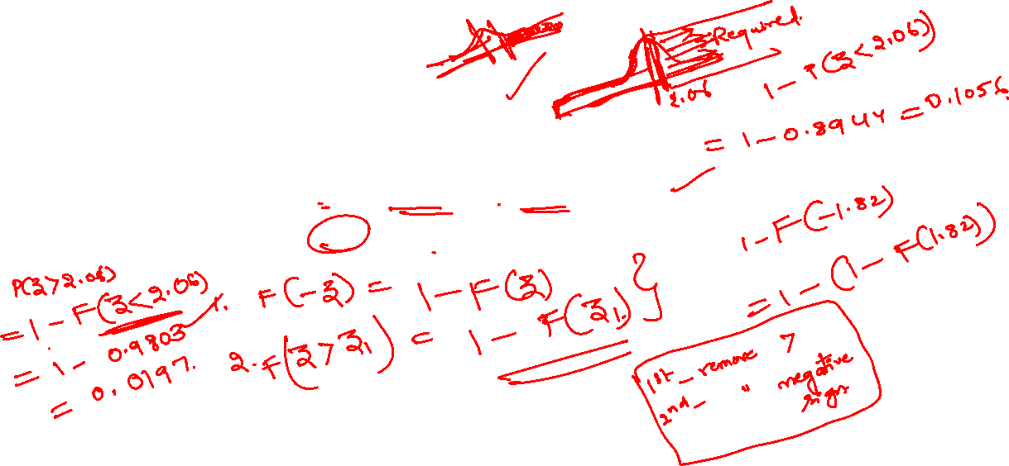
Example 9
If a random variable has the standard normal distribution, find the probability that it will take on a value
a)less than 1.75 = P(Z < 1.75) = F(1.75) = 0.9599
b)less than -1.25 = P(Z < -1.25) = F(-1.25) = 1 –F(1.25) = 0.1056
c)greater than 2.06 = P(Z >2.06) = 1 – F(2.06) =1-0.9803= 0.0197
d)greater than -1.82 = P(Z > -1.82) = 1- F(-1.82) =1-0.0344=0.9656

Slide 38

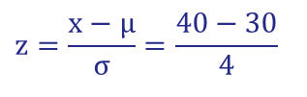
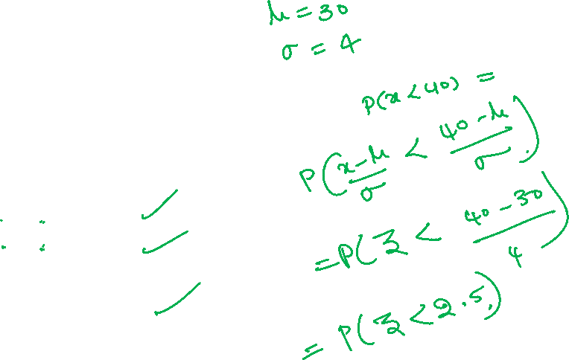
Example 10:
Scores on a particular test are normally distributed with a mean of 30 and standard deviation of 4. What is the probability of anyone scoring less than 40?
$$z=\frac{x−μ}{σ}=\frac{40−30}{4}$$
$$=2.5$$
μ = 30
σ = 4
P(x < 40)
x
μ =30
40
z
μ =0
?
2.5
P(x < 40) = P(z < 2.5) = 0.9938
The probability that a student receives a test score less than 40 is 0.9938.

Slide 39

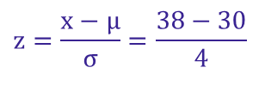

Example 11:
Scores on a particular test are normally distributed with a mean of 30 and standard deviation of 4. What is the probability of anyone scoring greater than 38?
$$z=\frac{x−μ}{σ}=\frac{38−30}{4}$$
$$=2$$
μ = 30
σ = 4
P(x > 35)
x
μ =30
38
z
μ =0
2.0
?
P(x > 38) = P(z > 2) = 1 − P(z < 2) = 1 − 0.9773 = 0.0227
The probability that a student receives a test score greater than 38 is 0.0227

Slide 40

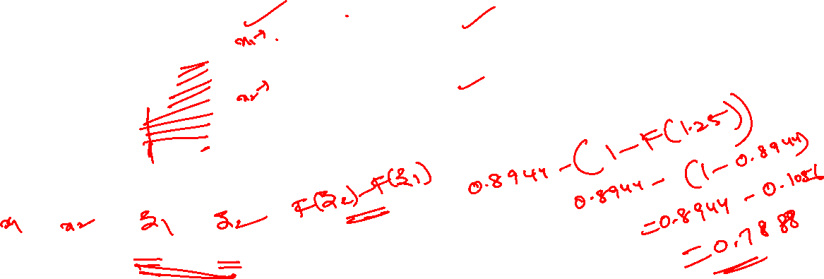
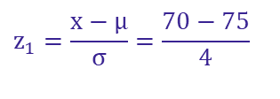


Example 12:
The average on a statistics test was 75 with a standard deviation of 4. If the test scores are normally distributed, find the probability that a student receives a test score between 70 and 80.
$$z_{1}=\frac{x−μ}{σ}=\frac{70−75}{4}$$
$=−$1.25
P(70 < x < 80)
$$z_{2}=\frac{x−μ}{σ}=\frac{80−75}{4}$$
$$=1.25$$
μ = 75
σ = 4
The probability that a student receives a test score between 70 and 80 is 0.7888
x
70
μ =75
80
z
−1.25
μ =0
1.25
?
?
P(70 < x < 80) = P(−1.25 < z < 1.25) = F(1.25) − F( −1.25)
= 0.8944 − 0.1056 = 0.7888

Slide 41
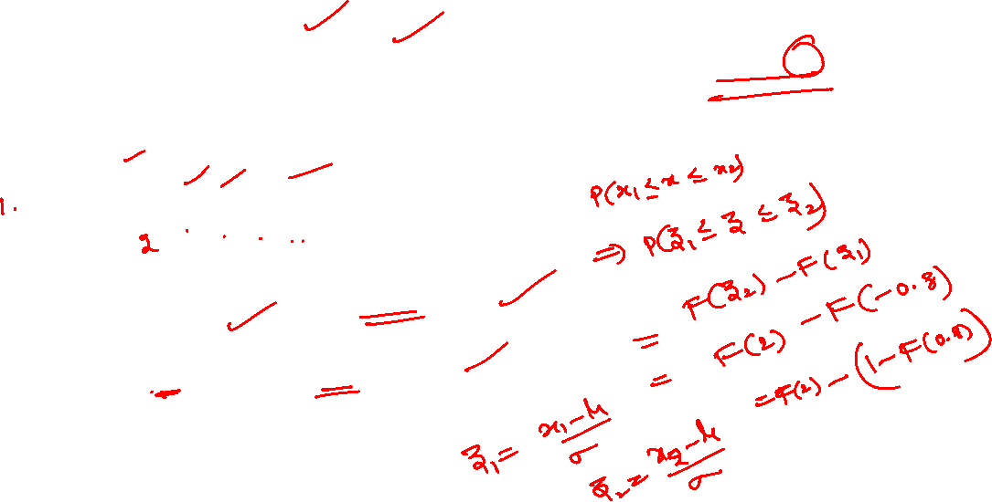
Example 13:
If X is a normal variate with mean 30 and SD 5. Find the probabilities that (i) 26≤ X ≤ 40 (ii) X > 45
Solution :
Here, mean μ= 30 and standard deviation σ = 5
(i) When X = 26
Z= (X - µ)/ σ= (26 – 30)/5 = –0.8 and
when X = 40 , Z = (40-30)/ 5= 2
Therefore, P(26 ≤ X ≤ 40) = F(2)-F(-0.8)=F(2)-(1-F(0.8))
=0.9773-1+0.7881=0.7654
(ii) P( X ≥ 45) = P(Z ≥ 3) = 1-F(3)=1-0.9986 = 0.0014

Slide 42

Normal Approximation to a Binomial Distribution
The normal distribution is used to approximate the binomial distribution when it would be impractical to use the binomial distribution to find a probability.
Normal Approximation to a Binomial Distribution
If np ≥ 15 and nq ≥15, then the binomial random variable x is approximately normally distributed with mean
and standard deviation

Slide 43







Normal Approximation to a Binomial Distribution
Correction for Continuity: Since the binomial distribution is discrete and the normal distribution is continuous, a continuity correction is applied. This involves adjusting the discrete binomial probability by 0.5 in either direction to account for the continuous nature of the normal distribution.
-When approximating 𝑃(𝑋≤𝑘), use 𝑃(𝑋≤𝑘+0.5)
- When approximating 𝑃(𝑋<𝑘), use 𝑃(𝑋<𝑘−0.5)
-When approximating 𝑃(𝑋≥𝑘), use 𝑃(𝑋≥𝑘−0.5)
-When approximating 𝑃(𝑋>𝑘), use 𝑃(𝑋>𝑘+0.5).

Slide 44

Example 14:
Decide whether the normal distribution to approximate x may be used in the following examples:
In a survey of 8 to 18-year-old heavy media users in the United States,47% said they get fair or poor grades (C’s or below). You randomly select forty-five 8 to 18-year-old heavy media users in the United States and ask them whether they get fair or poor grades.
Solution:
np = 45(0.47) = 21.15
nq = 45(0.53) = 23.85.

Slide 45

2. Thirty-six percent of people in the United States own a dog. You randomly select 25 people in the United States and ask them if they own a dog.
  Solution:
Because np is not greater than 15, the normal distribution may NOT be used.

Slide 46

Example 15:
Thirty-one percent of the seniors in a certain high school plan to attend college. If 50 students are randomly selected, find the probability that less than 14 students plan to attend college by normal approximation.
  Solution:
The variable x is approximately normally distributed with μ = np = 15.5 and
np = (50)(0.31) = 15.5
nq = (50)(0.69) = 34.5
P(x < 13.5)
= P(z < −0.61)
= 0.2709
μ= 15.5
Correction for continuity
13.5
x
10
15
20
The probability that less than 14 plan to attend college is 0.2709.

Slide 47





Introduction to Chi- Square distribution
$$\text{If }z_{1},z_{2},……,z_{k}\text{ are }N(0,1)$$
and y $=z_{1}^{2}+z_{2}^{2}+….+z_{k}^{2}$
$$\text{then y follows }χ^{2}\text{ with k dof.}$$
Chi-Square distribution pdf is given by
where k is the parameter of distribution, also known as degrees of freedom
$$f\left(x\right)=\left\{\begin{aligned}\frac{1}{2^{k/2}\left\lceil (\frac{k}{2})\right.}x^{\frac{k}{2}−1}e^{−\frac{x}{2}} for x>0 \\ 0 otherwise\end{aligned}\right.$$

Slide 48

Introduction to Chi- Square distribution
Chi-Square distribution curve is not symmetrical, and hence not a normal curve.
Chi-Square varies from 0 to ∞(Curve lies entirely in first quadrant).
It depends only on degrees of freedom k.
It is very important in estimation and hypothesis testing.
It is used in sampling distributions of the sample variance, analysis of variance.
It is used as a measure of goodness of fit.

Slide 49



Introduction to t-distribution
Use: If we come across the variable of the form “normal by square root of chi-square upon dof”
Where Numerator follows Z distribution and denominator follows chi-Square with n-1 dof.
$$t=\frac{\left.\sqrt{\left(\overline{x}−μ)/{\sqrt{\left({σ^{2}}/n\right)}}\right.}\right)}{\sqrt{\left({\frac{n−1)s^{2}}{σ^{2}}}/{\frac{1}{\left(n−1\right)}}\right.}}$$
$$t_{k}=\frac{z}{\sqrt{{x_{k}^{2}}/k}}$$

Slide 50




Introduction to t-distribution
$$\text{If }z\text{ and }χ_{k}^{2}\text{ are independent }\text{ normal }\text{ and chi−square variables, respectively.}\text{ then }$$
the random variable
$$t_{k}=\frac{z}{\sqrt{{x_{k}^{2}}/k}}$$
follows t distribution with k dof. The pdf of t is
$$f(t)=\frac{\left.Γ[\frac{k+1}{2}\right]}{\left.\sqrt{kπ}Γ(\frac{k}{2}\right)}\frac{1}{{\left[({t^{2}}/k)+1\right]}^{\frac{k+1}{2}}}$$

Slide 51



Introduction to t-distribution (Sampling distribution of mean when $σ$ unknown)
The t-distribution, also known as the Student's t-distribution, is a type of probability distribution that is similar to the normal distribution with its bell shape but has heavier tails.
It is used for estimating population parameters for small sample sizes when we don't know the standard deviation.
Where sample S.D. is calculated by formula

Slide 52



Introduction to F-distribution
Use when come across ratio of two chi- square variables and want to check which population have more variability.
The pdf for a random variable X ~ F (n₁, n₂) is given by
$$f\left(x\right)=\frac{Γ\left(\frac{n_{1}+n_{2}}{2}\right)}{Γ\left(\frac{n_{1}}{2}\right)Γ\left(\frac{n_{2}}{2}\right)}{\left(\frac{n_{1}}{n_{2}}\right)}^{\frac{n_{1}}{2}}x^{\frac{n_{1}}{2}−1}{\left(1+\frac{n_{1}}{n_{2}}x\right)}^{−\frac{n_{1}+n_{2}}{2}} ,x>0$$
F- distribution curve lies entirely in first quadrant.
The F- curve depends not only on the two parameters $θ1$ and $θ$₂ but also on the order in which they are stated.

Slide 53



Introduction to F-distribution
The F-distribution was developed by Fisher to study the behavior of two variances from random samples taken from two independent normal populations.
In applied problems we may be interested in knowing whether the population variances are equal or not, based on the response of the random samples.
If S₁² and S₂² are variances of independent random sample of size n₁ and n₂ from a normal populations with variances σ₁² and σ₂², then
which follows F –distribution with $θ1$ = n₁-1 and $θ$₂=n₂-1 d.o.f.
$$F=\frac{{S_{1}^{2}}/{σ_{1}^{2}}}{{S_{2}^{2}}/{σ_{2}^{2}}}$$

Slide 54
Practice Problem 1:
In a factory, 8% of all machines break down at least once a year. Use the Poisson approximation to the binomial distribution to determine the probabilities that among 25 machines (randomly chosen in the factory):
5 will break down at least once a year;
at least 4 will break down once a year:
anywhere from 3 to 8, inclusive, will break down at least once a year.

Slide 55

Solution:
$$λ=np=25×0.08=2$$
Apply Poisson distribution
a)P(X=5)
b)P(X$≥4)=1−P(X<4)$
c) P(3$≤x≤8)$=P(3)+P(4)+P(5)+P(6)+P(7)+P(8)

Slide 56

Practice Problem 2:
The average number of trucks arriving on any one day at a truck depot in a certain city is known to be 12. what is the probability that on a given day fewer than nine trucks will arrive at this depot?
Hint : $λ$ =12
Apply Poisson distribution
P(x<9) =P(x$≤$8)=P(0)+P(1)+P(2)+P(3)+P(4)+P(5)+P(6)+P(7)+P(8)

Slide 57

Practice Problem 3:
A certain kind of sheet metal has on the average, five defects per 10 square feet. If we assume a Poisson distribution, what is the probability that a 15-square-foot sheet of the metal will have at least six defects?
Hint : $λ=(15)5$/10=7.5
P(X$≥6)=1−P(X<6)$

Slide 58


Practice Problem 4:
What is the probability that a standard normal variate Z will be
(i) greater than 1.09
(ii) less than –1.65
(iii) lying between –1.00 and 1.96
(iv) lying between 1.25 and 2.75
Solution :
(i) greater than 1.09
The total area under the curve is equal to 1 , so that the total area to the right Z = 0 is 0.5 (since the curve is symmetrical).
The area between Z = 0 and 1.09 (from tables) is 0.3621
P(Z > 1.09) = 0.5000 – 0.3621 = 0.1379
The shaded area to the right of Z = 1.09 is the probability that Z will be greater than 1.09.
(ii) less than –1.65
The area between –1.65 and 0 is the same as area between 0 and 1.65.
In the table the area between zero and 1.65 is 0.4505
(from the table). Since the area to the left of zero is 0.5,
P(Z< 1.65) = 0.5000 – 0.4505 = 0.0495

Slide 59

Solution:
(iii) lying between –1.00 and 1.96
The probability that the random variable Z in between –1.00 and 1.96 is found by adding the corresponding areas :
Area between –1.00 and 1.96 = area between (–1.00 and 0) + area betwn (0 and 1.96) P(–1.00 < Z < 1.96) = P(–1.00 < Z < 0) + P(0 < Z < 1.96) = 0.8163
(iv) lying between 1.25 and 2.75:
Area between Z = 1.25 and 2.75 = area between (z = 0 and z = 2.75) – area between (z=0 and z = 1.25)
P(1.25 < Z < 2.75) = P(0 < Z < 2.75) – P(0 < Z < 1.25) = 0.1026

Slide 60
Practice Problem 5:
The length of life of an instrument produced by a machine has a normal distribution with a mean of 12 months and a standard deviation of 2 months. Find the probability that an instrument produced by this machine will last
a) less than 7 months.
b) between 7 and 12 months.
Solution: a) P(x < 7) = P(z < -2.5)= 0.0062
Hint: b) P( 7< x <12) = P(-2.5 < z < 0)= 0.4938

Slide 61
Practice Problem 6:
A computer crashes on average once every 4 months;
a) What is the probability that it will not crash in a period of 4 months?
b) What is the probability that it will crash once in a period of 4 months?
c) What is the probability that it will crash twice in a period of 4 months?
d) What is the probability that it will crash three times in a period of 4 months?
Hint:

Slide 62
Practice Problems :
7. If mean of the binomial distribution is 20 and the number of observations is 30. Find the variance and standard deviation.
Hint: n =30, np = 20;
8. The probability of a boy hitting a target is 0.2. How Many times must he fire so that the probability of his hitting the target at least once is greater than 2/3.
Hint: p= 0.2; P(X>=1) = 2/3, find n.
9. A box of candies has many different colors in it. There is a 15% chance of getting a pink candy. What is the probability that exactly 4 candies in a box are pink out of 10?
Hint: n = 10, p=0.15, q=0.85, x=4, Solution: P(x=4)= 0.04;

Slide 63
Example 10:
Find the binomial distribution if the mean is 6 and variance is 4.
Solution: n=18, p=1/3;

Slide 64
Example 11:
In a large number of parts manufactured by a machine , the mean number of
defectives in a sample of 20 is 2. Out of 1000 such samples , how many would be
expected to contain atleast 3 defective parts.
Sol: Given n=20;
Therefore the probability that there are at least 3 defective parts in a sample of 20 is
Hence out of 1000 samples we get 0.323*1000=323 samples

Slide 65
Example 12:
The number of customers arriving at a cafeteria at an average rate of 0.3 per minute.
(a) Find the probability that exactly 2 customers arrive in a 10-minute span.
(b) Find the probability that 2 or more customers arrive in a 10-minute span.
(c) Find the probability that exactly one customer arrives in a 5-minute span and one customer arrives in the next 5-minute span.

Slide 66

Solution:

Slide 67
Example 13:
Butterfly-style valves used in heating and ventilating industries have a high flow coefficient. Flow coefficient can be modeled by a normal distribution with mean 496 C_{v} and standard deviation 25C_{v}. Find the probability that a valve will have a flow coefficient of atleast 450C_{v}
P(X > 450) = P[( 450 – 496) /25] = P(Z > -1.84) = 1 – F(-1.84) = 1- 00329 = .9671
b) between 445.5 and 522C_{v}
P(445.5 <X <522) = P(-2.02 <Z <1.04) = F(1.04) – F(-2.02)= 0.8508 – 0.0217
=0.8291

Slide 68

Example 14:
If 62% of all clouds seeded with silver iodide show spectacular growth, What is the probability that among 40 clouds seeded with silver iodide at most 20 will show spectacular growth by normal approximation?
Soln: $Here n=40, p=0.62, q=0.38,$
$μ=np=24.8, σ^{2}=npq=9.424, σ=3.0699$
$$np≥15 and nq≥15$$
Therefore, we will use normal approximation to binomial distribution.
$$P\left(x≤20.5\right)=?$$
$$When x=20.5, Z=\frac{x−μ}{σ}=\frac{20.5−24.8}{3.0699}=−1.40$$
$$∴ P\left(x≤20.5\right)=P\left(Z≤−1.40\right)$$
$=F\left(−1.40\right)$ $=0.808$

Slide 69
Thank You!

